Slide 1

Genetic Algorithms
Programs that create the design

Slide 2
Emerging topics in Computer Science
Genetic Algorithms: program that design mechanisms by virtually evolving them over millions of generations.
The Most Fit: consider an optimal model that maximizes benefits and limits faults.
Airplane wing: maximize lift and strength, minimize weight and drag
Antennae: maximize clarity of signal, minimize interference
Elements can be compared by how fit they are

Slide 3
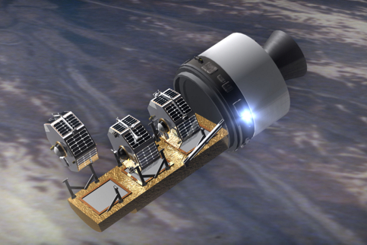


Genetic Algorithms in Antenna and Aircraft Wing Design

Slide 4
Genetic Algorithms
Start with a base model (a Widget)
Create an array of Widgets, where each element is a slight mutation of the base model.
Mutation set by a MUTATION_RATE (percent)
Each aspect of the Widget can vary by that percent
Find the Most Fit element of the Array
Make the Most Fit seed the next generation.
Continue over many generations to evolve the Widget in the direction of the Most Fit.

Slide 5
A Simple Genetic Algorithm
Consider we want to evolve a number.
The fitness of a number is determined by how small it is.
The Most Fit number will be 0.0
1) Create an array
2) Make the first element a random number
3) Fill the rest of the array with slight mutations of that number
4) Sort the array (so the Most Fit is at index 0)
5) Repeat until the first element is optimal (or close enough)

Slide 6
public static int SAMPLE_SIZE = 10, MUTATE_RATE = 5; public static double ALMOST_ZERO = 4.9E-323; public static void main(String[]arg) { double [] nums = new double[SAMPLE_SIZE]; int numGenerations = 0; nums[0] = Math.random()*100; while(nums[0] > ALMOST_ZERO) { System.out.println(nums[0]); for(int i=1; i<nums.length; i++) nums[i] = mutate(nums[0]); Arrays.sort(nums); numGenerations++; } System.out.println("Evolved after " + numGenerations + " generations.");
public static double mutate(double x) { if(Math.random() < 0.5) x = x + (x * (Math.random()*MUTATE_RATE/100)); else x = x - (x * (Math.random()*MUTATE_RATE/100)); if (x < 0) x = 0; return x; }

Slide 7
Your Assignment: Tree Evolve
Tree Object:
public Tree makeRandomTree()
//returns a random Tree fractal
public Tree mutate(int mutationRate)
//given the current tree, return an almost-clone of the tree (child)
//where each field can vary by mutationRate
public int compareTo(Object other)
//Trees compare to one another by how fit they are
//(one that is more fit is > one that is less fit)

Slide 8
In TreePanel.java
private static Tree [] forest; //most fit is at forest[0] private static int SAMPLE_SIZE = 10; //number of trees to mutate (2-25) private static int MUTATION_RATE = 5; //percentage a tree can mutate (1-100) private static int numGenerations; //count the number of generations
Complete the code to advance the evolution of trees by one generation.
private static void advanceGeneration()
{
numGenerations++;
//***Complete the code here to find the most fit tree,
//***place the most fit tree at index 0
//***repopulate the rest of the forest with children of the most fit
//***allowing each child to differ from the best by the MUTATION_RATE
//***********************/
}

Slide 9
In TreePanel.java
The client will have the option of pausing evolution (right mouse click) in order to adjust the sample size (# of children in forest) or the mutation rate. Complete the code to allow the client to make the forest one larger or one smaller. The more children there are, the more likely it will be that a child will be more fit than the parent, but will require more processing to find the most fit.
private void keyPressed(KeyEvent e)
{
if(e.getKeyCode()==KeyEvent.VK_1) //Sample Size (2-25) { if(SAMPLE_SIZE <= 2) return; SAMPLE_SIZE--; //***COMPLETE THE CODE HERE*****************************************
//***make a new Tree array that is one-element smaller than forest
//***copy elements from forest to the new smaller array
//***change forest to be the new smaller array.
//***Similar code should be done to increase the sample size by one. //******************************************************************/ repaint(); return; }

